Slide 1

Two classroom- and computer-based middle school programs:
“Risk Reduction”
“Risk Avoidance”
Logo on website
Claims:
“Evidence-Based Comprehensive Program”
“Theory-Based Pregnancy, HIV, and Sexually Transmitted Disease Prevention Program”
“grounded in theory” and “developed to prevent teen pregnancy and sexually transmitted diseases (STDs), including HIV.”
“emphasizes abstinence but also teaches students how to protect themselves from pregnancy and STDs using medically accurate information.”
ITG was developed at UT Prevention Research Center
Source: www.itsyourgame.org
Notes:
Abstinence is not emphasized in either of the two programs. “Risk Avoidance” is not used anywhere that I know of.

Slide 2
Role playing scripts
Students call other students names like ho, slut, lame, sleazy, loser, idiot, and gay.
“Evidence-Based script lines,” such as:
“Oh my God” and “This sucks.”
“They were making out and he started feeling on her, you know, ‘down there.’”
“And then she started to feel on him, too”
Notes:
Student Handbook – students couldn’t use terms like these.

Slide 3
It’s Your Game
Does not comply with the law (TEC 28) which mandates that human sexuality instruction must:
“present abstinence from sexual activity as the preferred choice of behavior in relationship to all sexual activity for unmarried persons of school age”
“devote more attention to abstinence from sexual activity than to any other behavior”
Notes:
Most parents don’t know this, and what can they do if they do know?

Slide 4
Role play lines - Excerpts
“People are talking about me behind my back, calling me a slut and a ho.”
“I just found out that Rosa’s pregnant. I wish I could call her a slut.”
“Well, I was at a party a couple of weeks ago, and I, ah, ended up having sex with this guy.”
“They were making out and he started feeling on her, you know, “down there.” And then she started to feel on him, too.”
“She is really hot and I’ve been thinking that maybe it will be OK to mess around a little more than just kissing.”
“I think we should do more than just kissing and touching.”
“I just feel so close to you. That’s why I want to have sex with you.”
“If we use a condom, it will spoil the mood.”
“You just need to do it, and then you’ll realize sex is no big deal.”

Slide 5
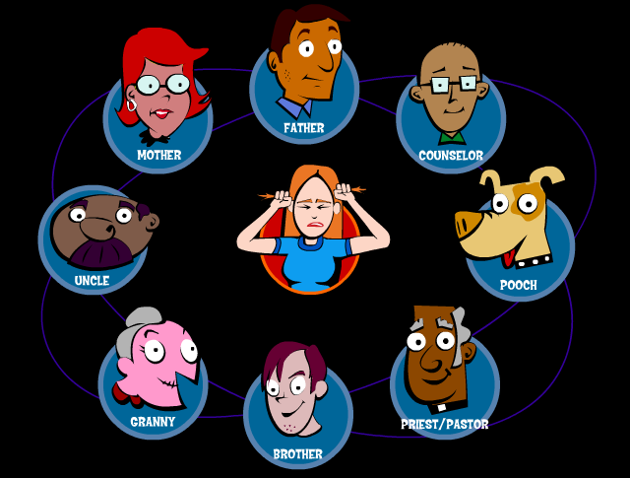
Students are not directed to their parents
Students are told to click on people that teens go to when they have problems in their “game.” (Level 1, Lesson 3)
Students are not directed to parents as the best and most important option – but only one among several choices.
Notes:
All choices are presented as equal.

Slide 6
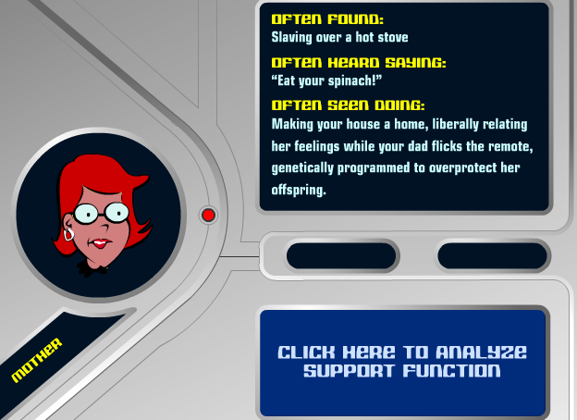
Authority figures are mocked
Mothers are stereotyped – not portrayed as someone to talk to about sex.
Notes:
Instead, they are depicted in a “support” role in the areas of “relationships, school, money, and work.”

Slide 7
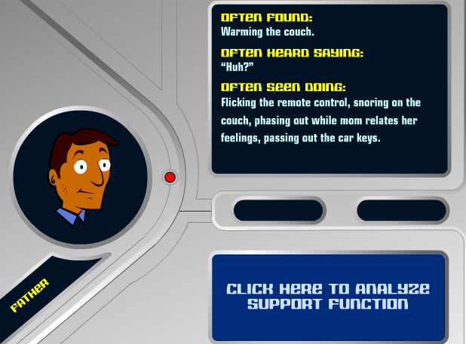
Dads portrayed as insignificant
Couch-potato Dad is not portrayed as someone to talk to about sex but as a source of “support” in the “areas of work, money, school, and relationships.”

Slide 8
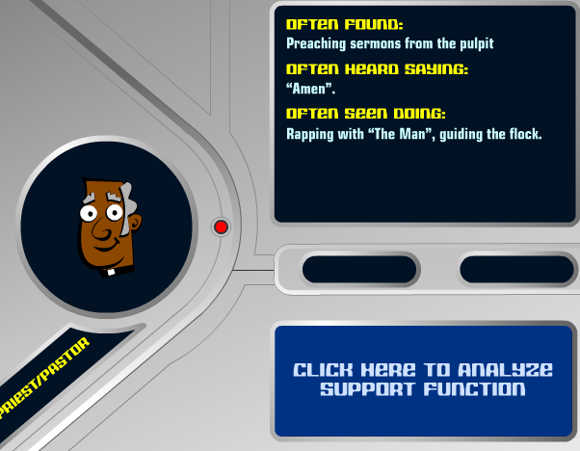
Clergy mocked
God is referred to as “The Man,” and the pastor is portrayed as “rapping” with him.

Slide 9
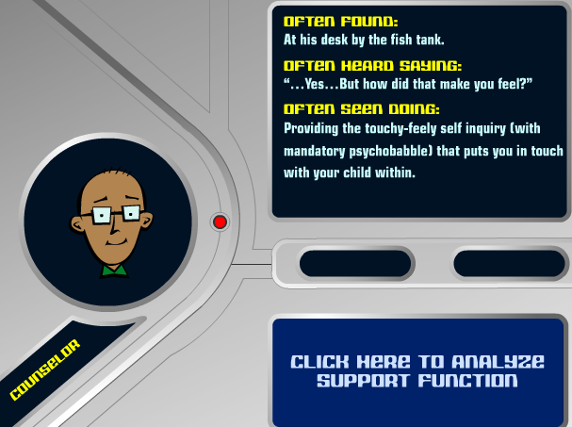
Counselors: “touchy-feely self inquiry ” … “psychobabble”
Notes:
What student would want to go to a counselor after a description like this?

Slide 10
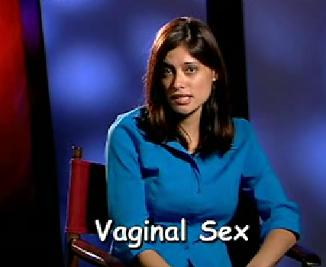
It’s Your Game defines sex
The “expert” clarifies that when the program refers to sex, it is talking about vaginal, oral, and anal sex.
Level 1, Lesson 8
Notes:
This is used for children as young as 11.

Slide 11
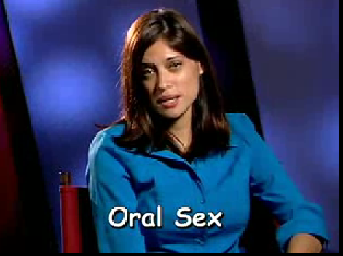
Expert defines oral sex …
“when someone puts his or her mouth on someone’s penis, vagina or anus, that means their butt.”

Slide 12
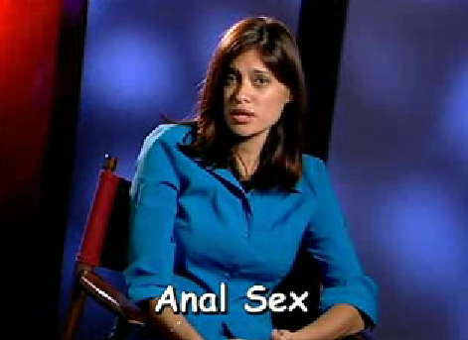
Anal sex defined …
“when a man puts his penis in his partner’s butt.”
Notes:
Nothing is discussed in terms of marriage – only “partner”

Slide 13
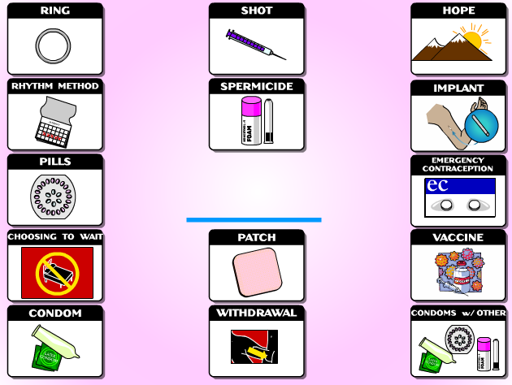
Contraception
11 to 13 year-old-students are given information on each choice.
They are not told of the side effects associated with their use.
(Level 1, Lesson 10
Also is Level 2)

Slide 14
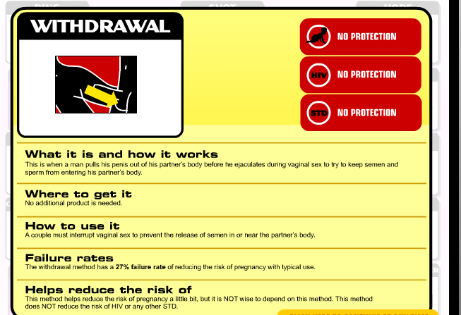
Notes:
Students are never guided to the best choice. They can choose which options to click on and spend as little or much time as they like on each.

Slide 15
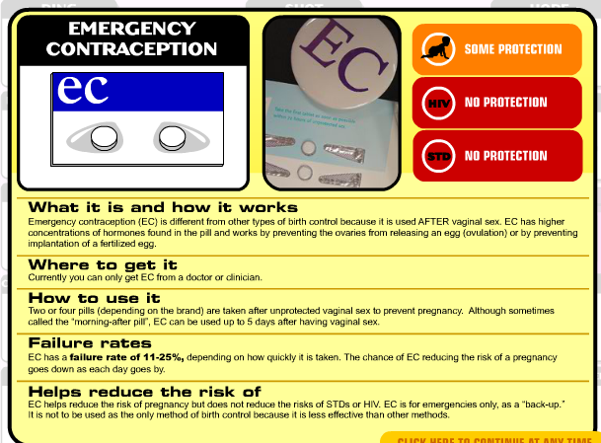
“Morning After” Pill

Slide 16
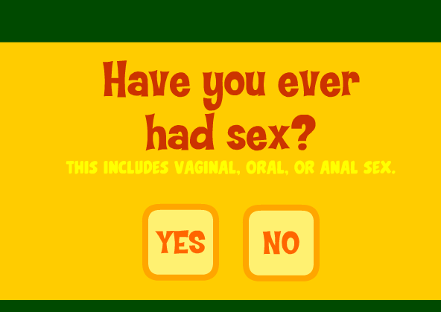
Students are questioned about their personal lives
Notes:
Are students’ answers are recorded? Who has access to this information?
Are student’s answers recorded? Who has access to this information?

Slide 17
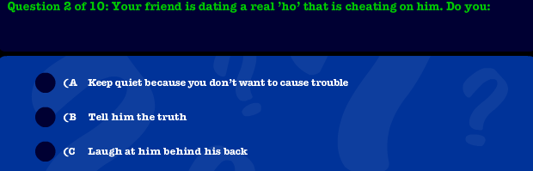
“Your friend is dating a real ‘ho’ …”
One of the questions asked to determine if a student is a “real” friend.

Slide 18
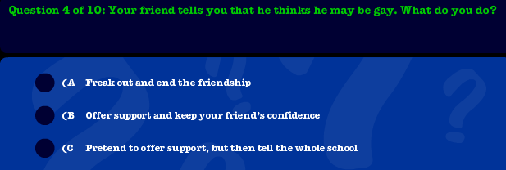
Students asked about having a gay friend
Purpose of lesson: Determine if you’re a “good” friend. The answers choices draw students to option “B.”
Notes:
There is no option if a student thinks homosexuality is harmful.

Slide 19
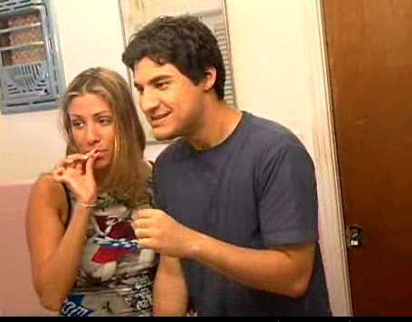
Video shows pot smoking
Instead of facts about the harm of drugs, students are depicted smoking pot.
Lesson 1, Level 1
Notes:
Once you show young students this, you plant in their minds teens smoking pot.

Slide 20
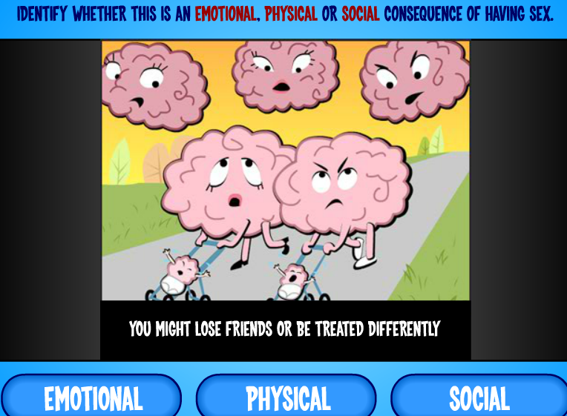
Teen “brains” have sex after just meeting
The two “brains” go back to her house where parents aren’t home.
The sun goes down, the stars come out, a strobe light flashes from the window, while the “brains” have sex and groan.
(Video lesson)

Slide 21
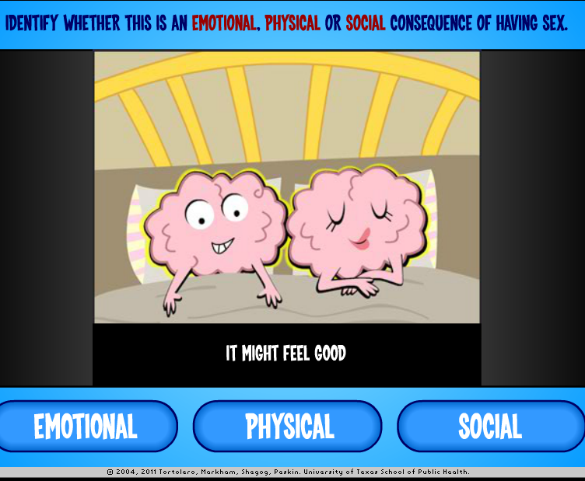
Students told that sex
“might feel good”
(Video)

Slide 22
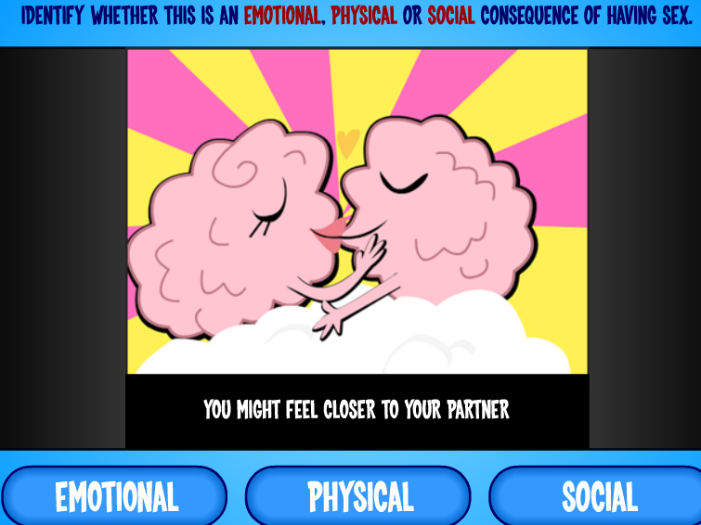
Students told sex might make you “feel closer”

Slide 23
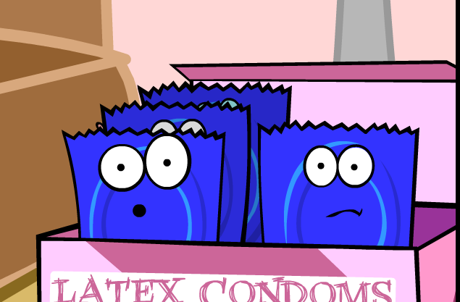
The “Condom Platoon”
Animated talking condoms video
Each condom has a name; they scream, talk about being “ribbed,” “ultrasheer,” and “show offs” like “glow in the dark.”
Condoms talk about “pre cum” and slipping off, and they exclaim they are too young to die when accidently cut; and, scream of burning when Vaseline is used.
Notes:
Used to be a video on utube but

Slide 24
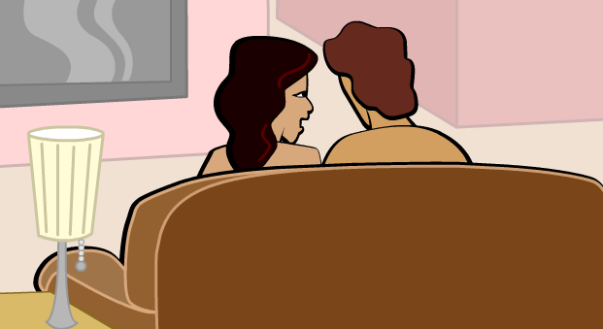
Marvin and Lisa “want to have sex”
“Marvin is 19 and his girlfriend Lisa really care about each other, might get married someday, it is that special moment, the lights are right and they want to have sex.”
Screen shot of a video, Level 2, Lesson 5,
Notes:
The animated condoms poke fun at Marvin, a first time user of condoms. He cuts one with scissors, rolls one on the wrong way… the condoms scream about burning because the condom breaks. The point is that he should practice first before the actual moment to get it right.

Slide 25
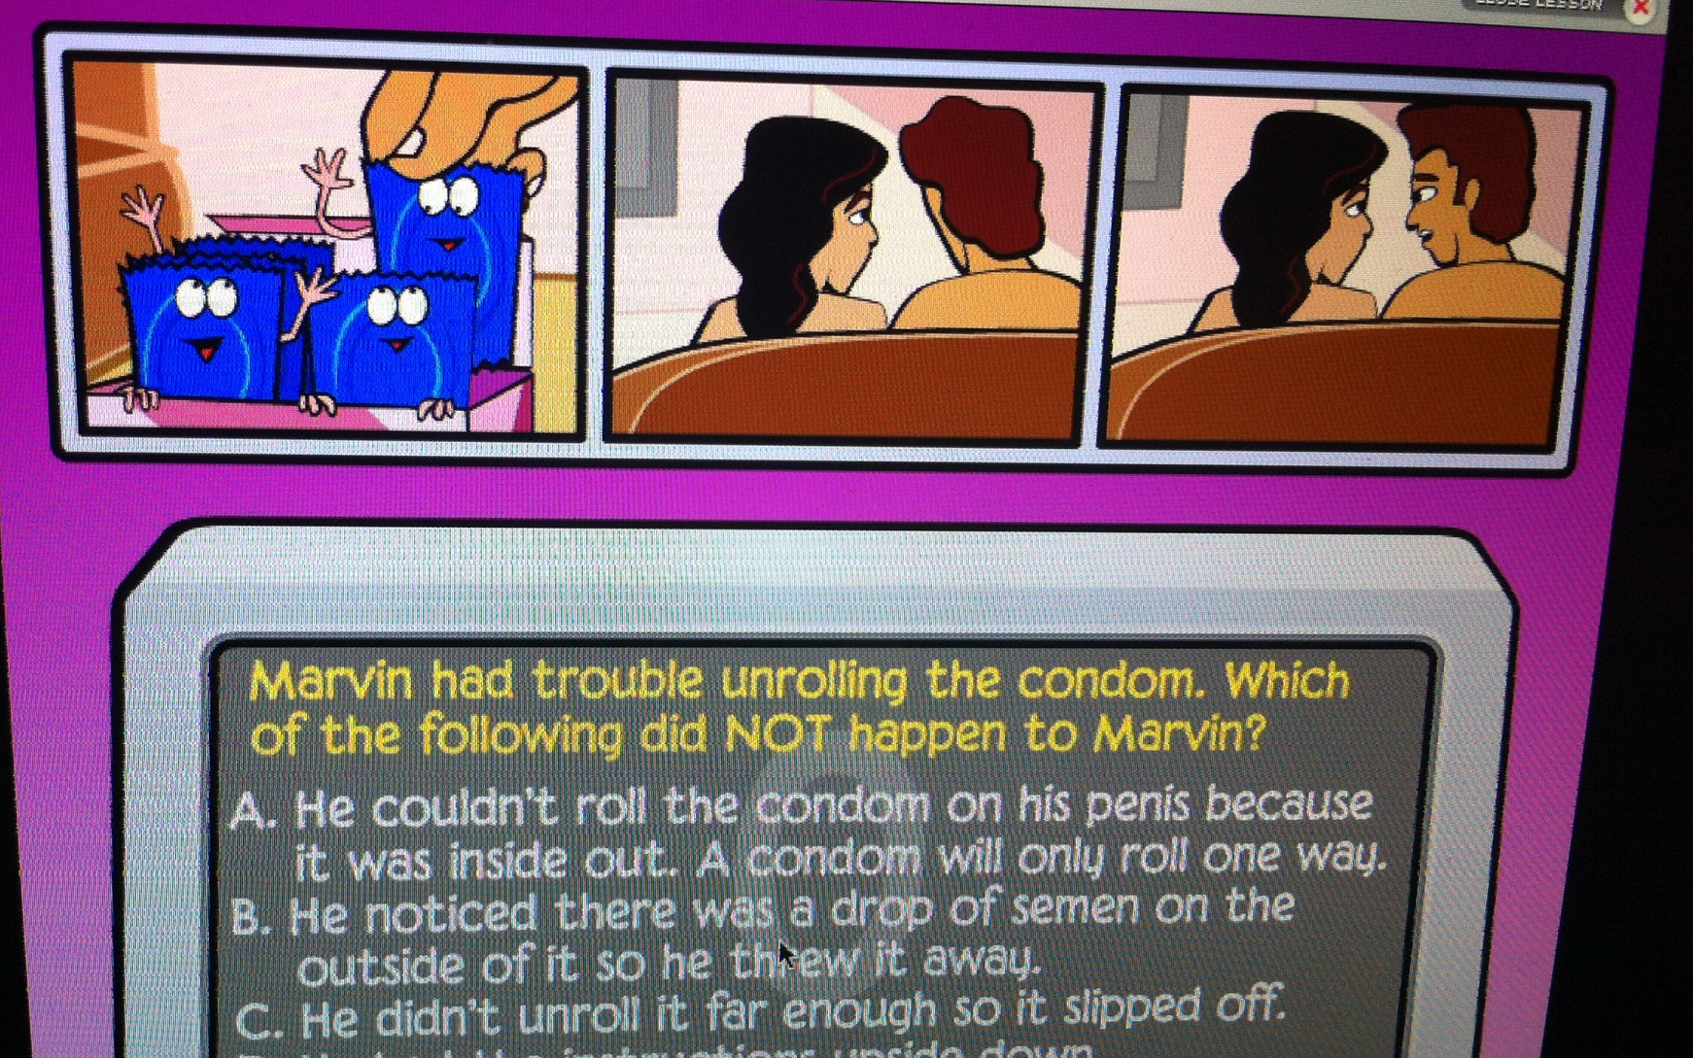
Students are asked to determine
Marvin’s trouble with condoms.

Slide 26
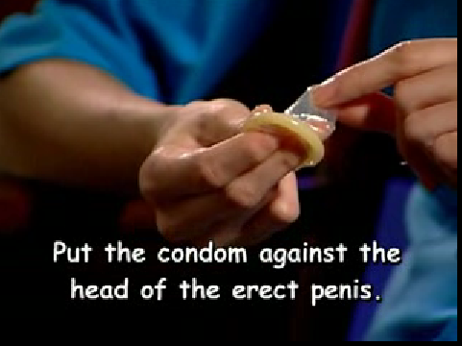
Condom demonstration video

Slide 27
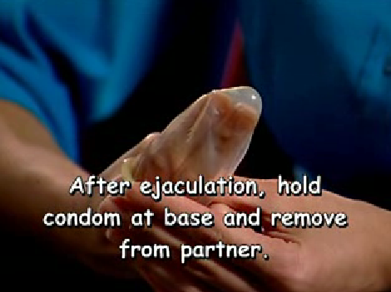
Condom demonstration video

Slide 28
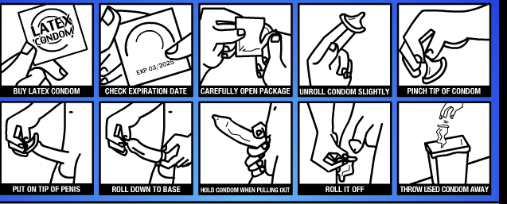
Condom Game
Students are given these pictures out of order and told to put them in order.
Level 2, lesson 5

Slide 29
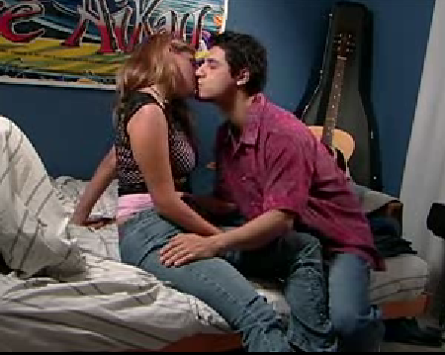
Manuel and Shannon’s first date …
He suggests they have sex. He doesn’t have a condom, so he says he knows “she wants to please him and she can do it in other ways.”
He begins to undress as the camera fades out.
In the next lesson, Shannon tells her friend that she got Herpes after performing oral sex on Manuel. But after they talk about it, she loves and trusts him more, they are in a better place, and really care for each other.
… they’re making out on his bed. His parents aren’t home. Level 2, lesson 3
Notes:
The students are asked about oral sex later in the lesson.

Slide 30
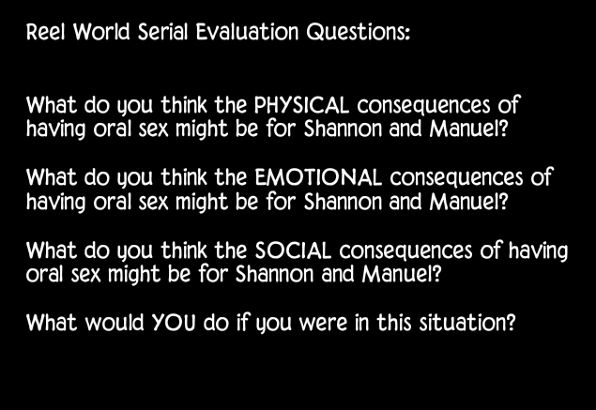
Students are asked what they think
Notes:
Again, ITG doesn’t direct students to a standard of behavior.

Slide 31
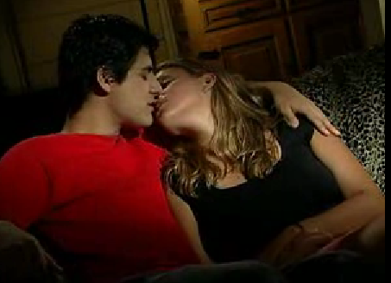
Manuel wants to have sex again
Shannon suggests a condom. Manuel is disappointed because “condoms kill it, you know?”

Slide 32
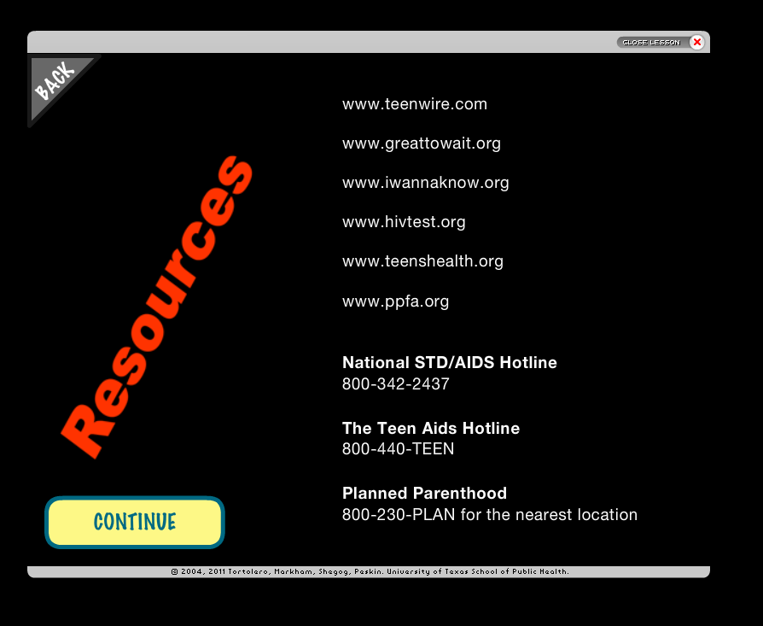
Students are referred to
Planned Parenthood
Students are directed to Planned Parenthood and its websites.
Note: Planned Parenthood’s Teenwire website has been changed to http://www.plannedparenthood.org/info-for-teens, which is listed on UTPRC’s website under “Cool Links.”
Level 1
Lesson 10
Notes:
This screen is not on the teacher’s version; it’s only the student’s version.

